Slide 1
On the Importance of Touch and Embrace in Gibbons:
A Comparative Study of the Gibbon Genera Nomascus and Hoolock
Peyton A. Allen

Slide 2
Researchers
Peyton Allen
(She/They)
Anthropology & Psychology (B.A. ‘25)
Mentor: Dr. Brittany Florkiewicz
(She/They)
Anthropology (Ph.D ‘22)
Psychology Department, Lyon University

Slide 3
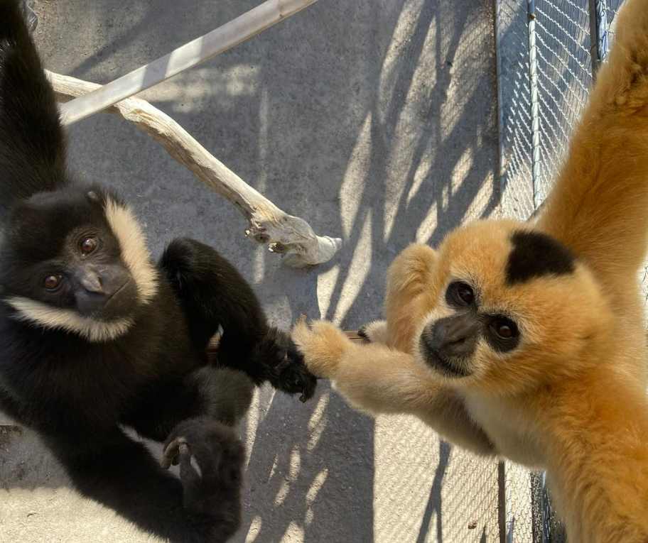
Background
@gibbonconservationcenter
Lack of research on “lesser” apes
Perceived cognitive differences
Importance of gibbon research
Conservation efforts (SSPs)
Evolutionary origins of behavior
My research: touch-based interactions and social bonding in gibbons
@gibbonconservationcenter
@gibbonconservationcenter
Notes:
· Research on gibbon social behavior is sparse in comparison to other ape species. This is primarily due to the fact that gibbons are perceived as being cognitively & socially inept compared to great apes.
· Gibbons live in relatively small social groups which are maintained over time through pair bonding. (Pair bonding details)
· Most research to date has focused on grooming and close proximity to quantify the strength of gibbon social bonds; however, gibbons display a wide variety of affiliative behaviors which may also be important in bond development and maintenance.

Slide 4
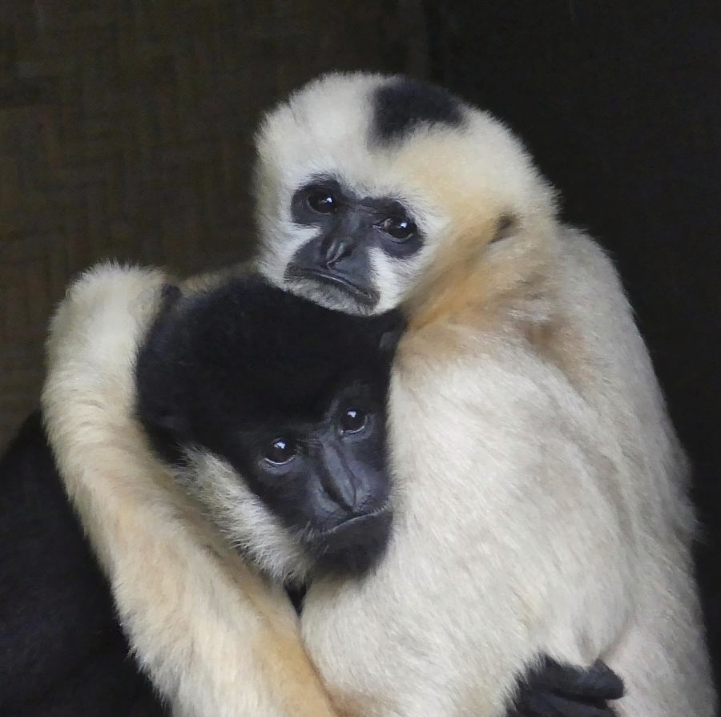
Diversity of Touch
Grooming: The use of fingers to separate hairs in an effort to see beneath
Non-Grooming: petting, huddling, one or both hands/feet placed on the recipient in a resting position
Embrace: one or both arms/legs covering the recipient in the sitting position
by Margaret Saheed
Notes:
· The goal of my study was to examine the relationship between pair bond strength and affiliative touch among two genera of gibbons (Nomascus spp. & Hoolock spp).
· I predicted that gibbon pairs with stronger bonds would exhibit an increased frequency in affiliative touch behaviors. I also examined whether there were different forms of affiliative touch among the two genera.

Slide 5
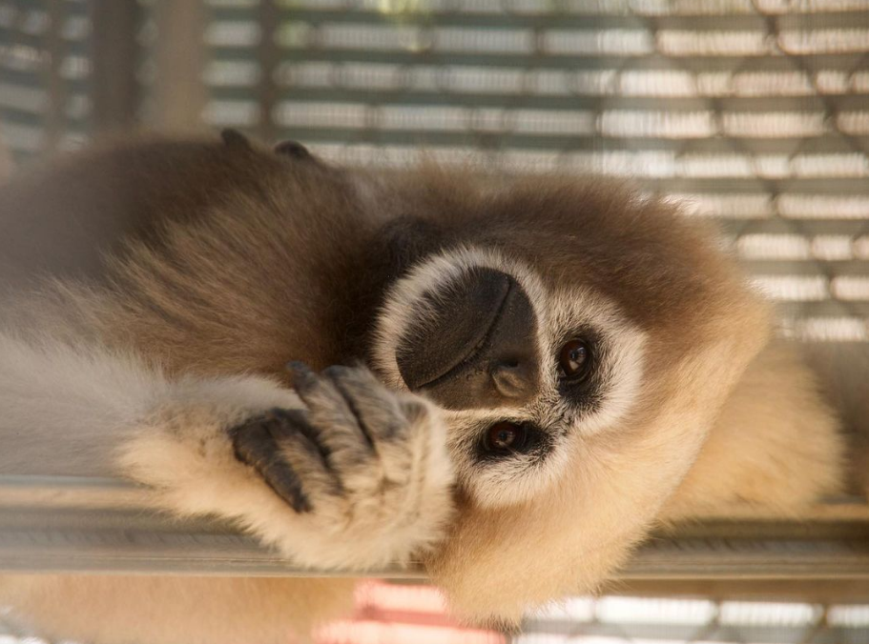
Predictions
Prediction 1: Gibbons with stronger pair bonds will exhibit more touch-based interactions
Prediction 2: Gibbons should exhibit more grooming behaviors than touch-based behaviors
Explore: differences among genera & species?
@gibbonconservationcenter
Notes:
I predicted that there would be small interspecific differences, allowing us to understand the importance of each touch based interaction;. I thought that certain interactions held a social weight, for example a handshake vs a hug for us, grooming vs embracing for them.

Slide 6
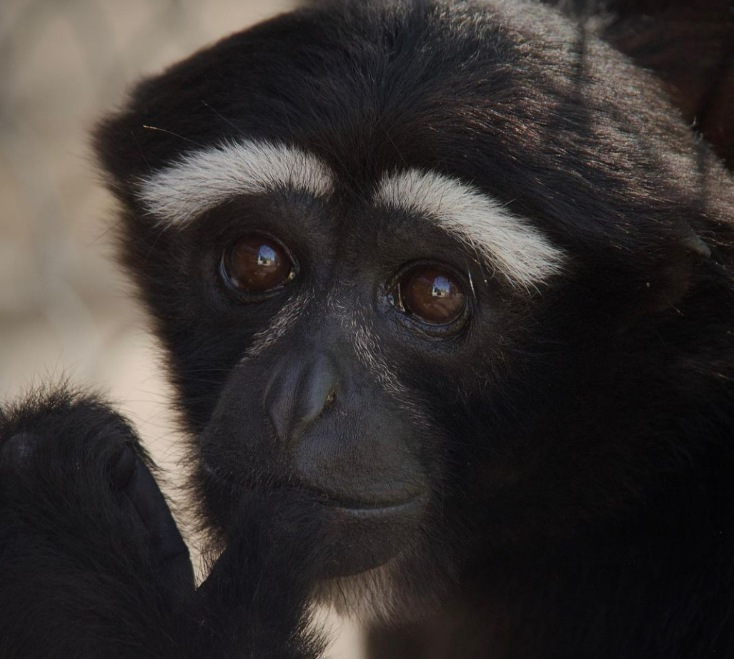
Data Collection From GCC
Species:
White-cheeked gibbons
Eastern Hoolock
Western Hoolock
Methods:
Focal Sampling (2015)
1 hour video recordings
Sample by pair (N = 7)
Coded social interactions (2022)
@gibbonconservationcenter
Notes:
only 20 minutes out of each recording were used

Slide 7
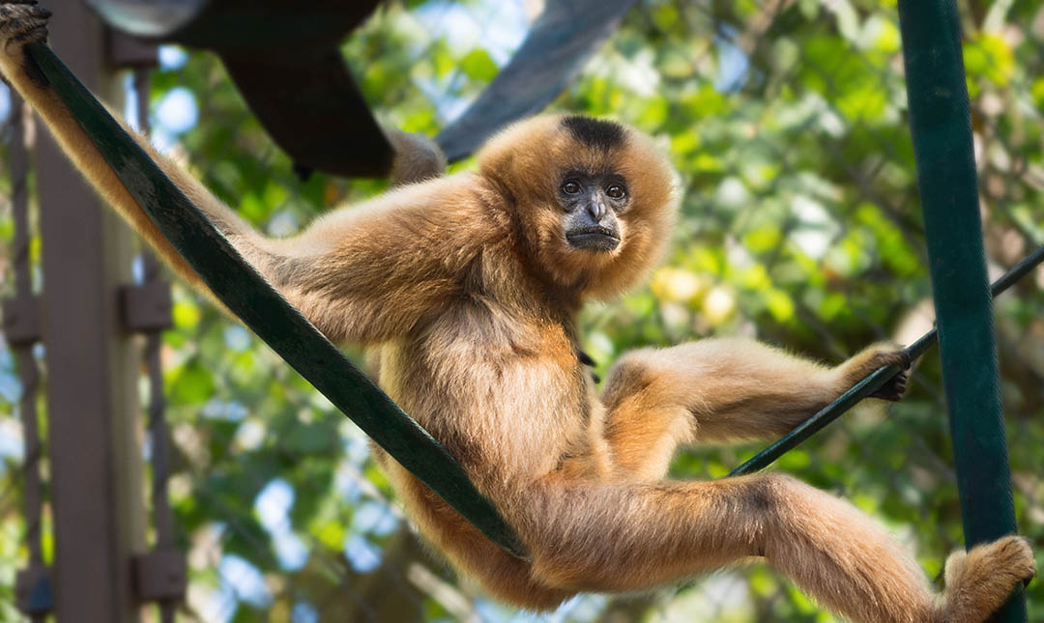
Data Collection at Los Angeles Zoo
Species: Buff-Cheeked Gibbons
Methods:
Focal Sampling (2022)
20 minute observations
Sample by pair (N = 4)
Coded social interactions (2022)
@LA Zoo
Notes:
Charted in notebook, timed for 20 minutes, not recorded videos

Slide 8
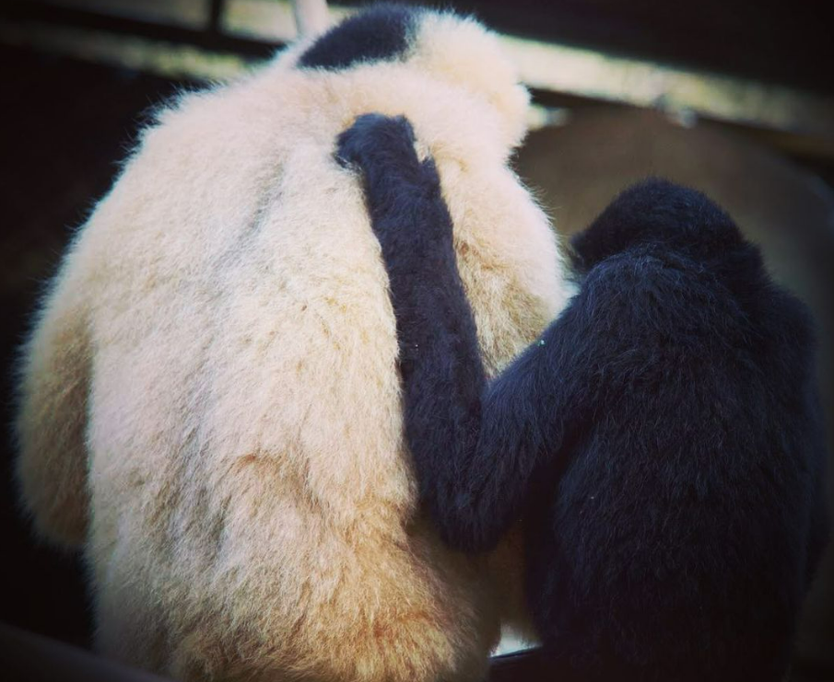
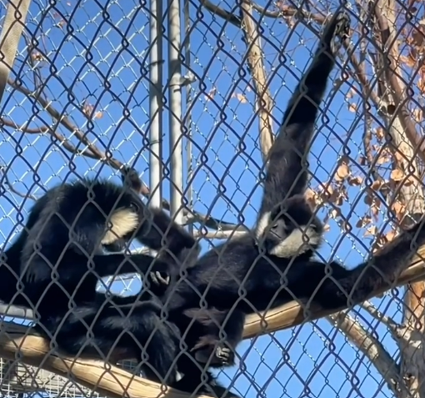
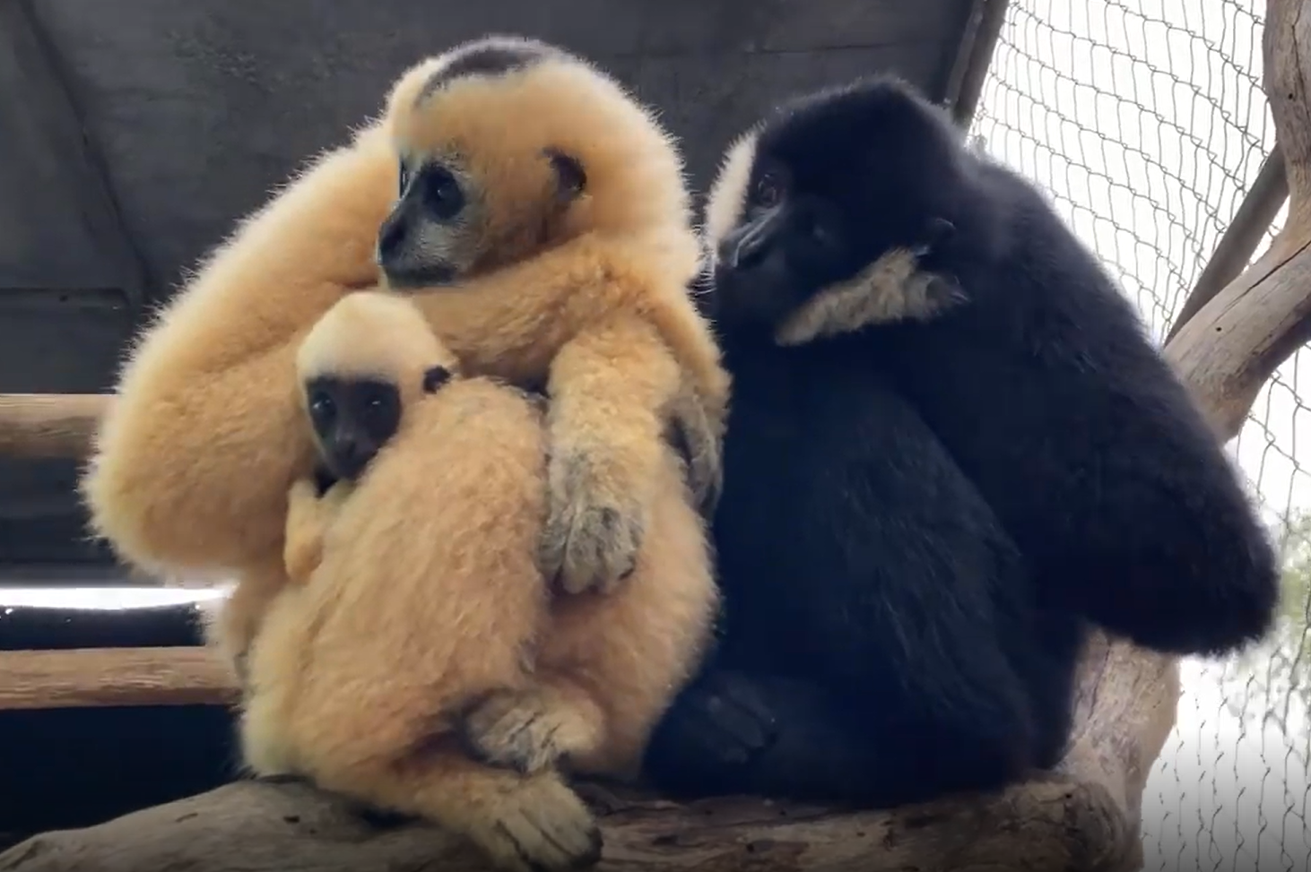
Contact Types
Grooming
Embrace
@gibbonconservationcenter
@gibbonconservationcenter
Huddling
@gibbonconservationcenter
Focused on previously described contact types

Slide 9
Videos
Embrace
Grooming

Slide 10
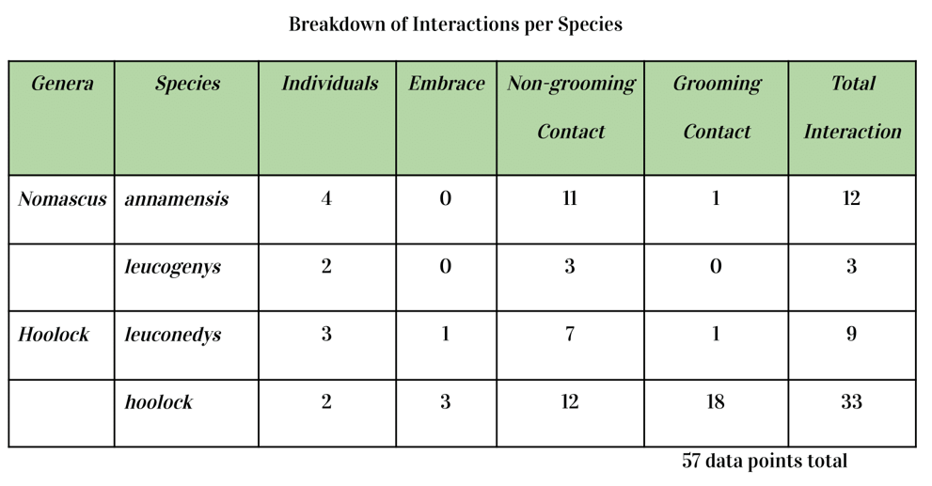
Data Analysis
Statistical Test
Kruskal-Wallis Test
Observations
Non-Grooming: 57.8%
Grooming: 35%
Embrace: 7.2%
Results
No significant differences
…but pattern observed!
Notes:
To observe this data, a rank-based nonparametric test was utilized. The Kruskal-Wallis test was run twice: once to observe the significance of contact type within interaction, and again to observe the significance of species type on interaction.
Of the total observations, 57.8% of encounters resulted in non-grooming contact, 35% resulted in grooming contact, and 7.2% resulted in embrace. Based upon the raw data, there seems to be a pattern based on contact type which details a non-grooming encounter taking place before and after a grooming session; this was primarily reported in the Hoolock Hoolock gibbons.
Despite the noticeable difference between the total interaction types displayed in the table, data analysis using Kruskal-Wallis methods yielded that the results are not statistically significant. Therefore, the hypothesis is not supported by this dataset; there are no significant interspecific differences.
After analyzing my data, I found no significant relationship between pair bond strength and affiliative touch. However, I did observe differences in the frequency of affiliative touch behaviors (and bouts of grooming) among both genera.

Slide 11
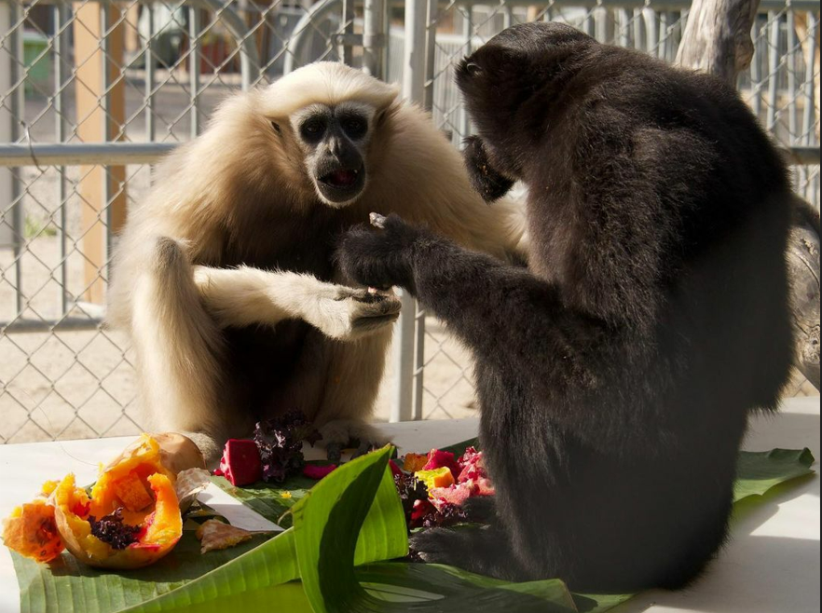
Future Research
Future Considerations: Reciprocity of affiliative behaviors & increase sample size
Functional differences: of embrace, touch, & grooming behaviors
Future Studies: intraspecific differences & influence of context
@gibbonconservationcenter

Slide 12
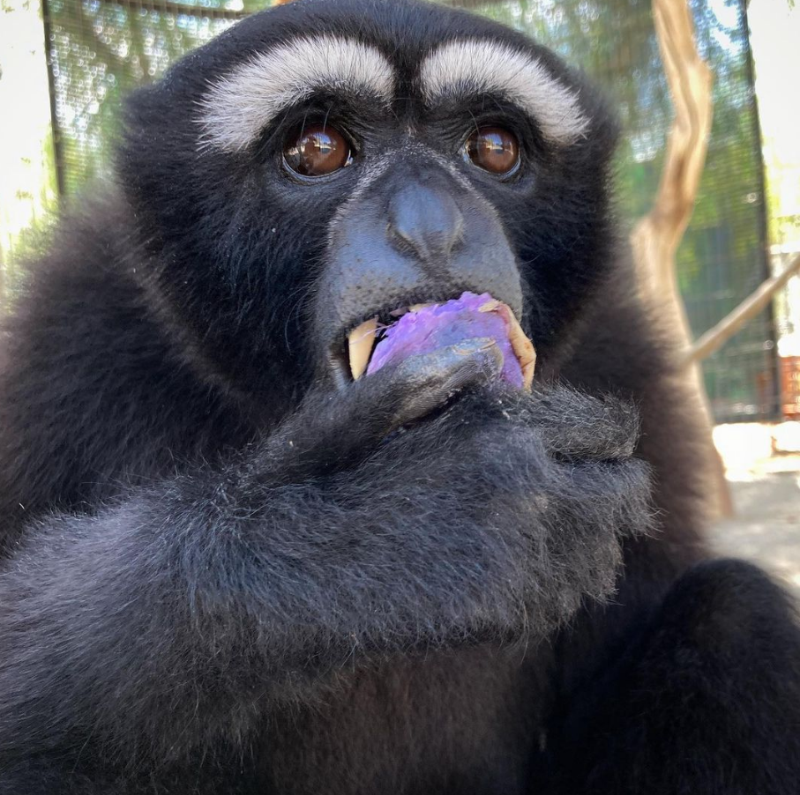
Acknowledgements
Special thanks to you all!
Britt Florkiewicz (UCLA Mentor)
Syd, Ethan, Bella (for reading over every paper)
GCC Instagram (photography)
Primate Keepers at the LA Zoo & GCC
All my lovely apes at both the LA Zoo and GCC, I hope to work with you again soon!
& For your attention today
@gibbonconservationcenter

Slide 13
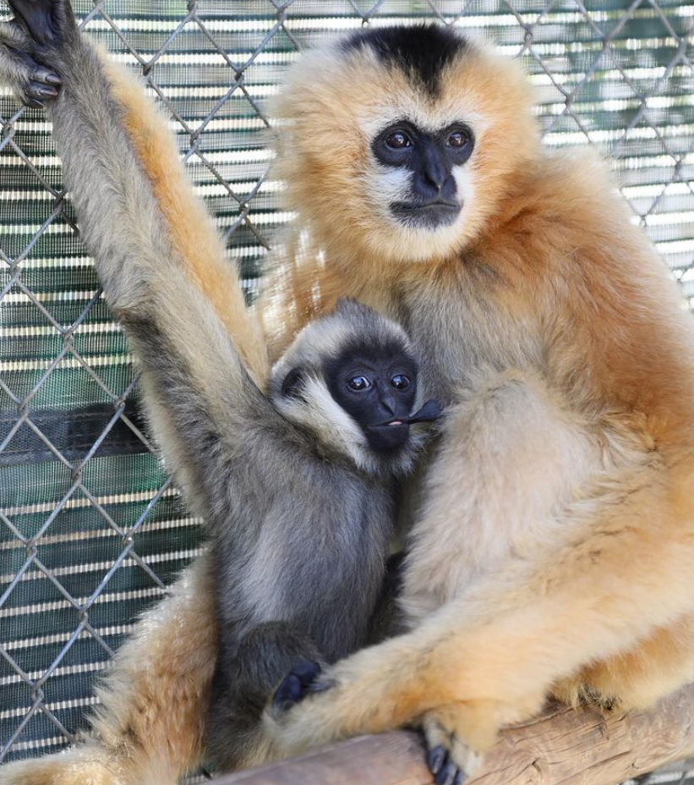
Sources
Photos: GCC instagram, LA zoo website
Embrace video: https://youtu.be/ZONKHOdQA5k
Grooming Video: https://youtu.be/033wTIWkh1E
(0:16-0:38)
@gibbonconservationcenter

